Slide 1
An adaptation of hybrid binary optimization algorithms for medical image feature selection in neural network for classification of breast cancer
JUSTICE TETTEH(10981523)
EMMANUELLA POKUAA DANSO(10980151)

Slide 2
Adjustments to Compartmental
1. To prevent no individuals in been infected we prevent individual from recovery or death supposed only one person is infected. To prevent early convergence. And aid exploration.
2. If we are all get infected we recover 50 percent of the entire population. To enable exploration of more features in the compartmental model
3. Maintain ODEINT as a while creating Creating ODE45

Slide 3
Suggested
BDMO
BPSO
BSA
FFA
BGWO
ACO
BSO

Slide 4
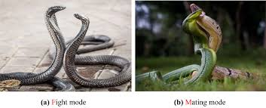
What is Snake optimizer
The Snake Optimization Algorithm (SO) is a nature-inspired metaheuristic optimization algorithm that mimics the foraging and reproductive behaviours of snakes to solve complex optimization problems.
Proposed by Hashim and Hussien in 2022, SO simulates how snakes search for food, fight, and mate under varying environmental conditions (e.g., food availability and temperature)

Slide 5
Research Document by: Xinyu Bao, Hui Kang & Hongjuan Li : Published 2024
This focuses on the use of SO as a mechanism for feature feature selection and or solving optimization problems
We employ the mechanisms used by this research for calculating
1. Temperature ( temp)
2. Food quantity (Q)
And other factors used for randomised conditions for feature selection.
3. Other parameters thus( thresholds needed for the algorithm to work)

Slide 6
Why BSO
Complementary Search Strategies
BSO balances exploration (Q < 0.25) and exploitation (Q ≥ 0.25).
HBEOSA uses Ebola-inspired dynamics for search.
Benefit: Enhances exploration and refines feature subsets.
Enhanced Solution Diversity
BSO’s fight/mating modes promote diverse feature combinations.
HBEOSA’s infection/recovery adds unique dynamics.
Benefit: Reduces redundant or suboptimal feature subsets.
High-Dimensional Efficiency
BSO navigates large feature spaces effectively.
HBEOSA excels in binary optimization.
Benefit: Scales well for high-dimensional datasets

Slide 7
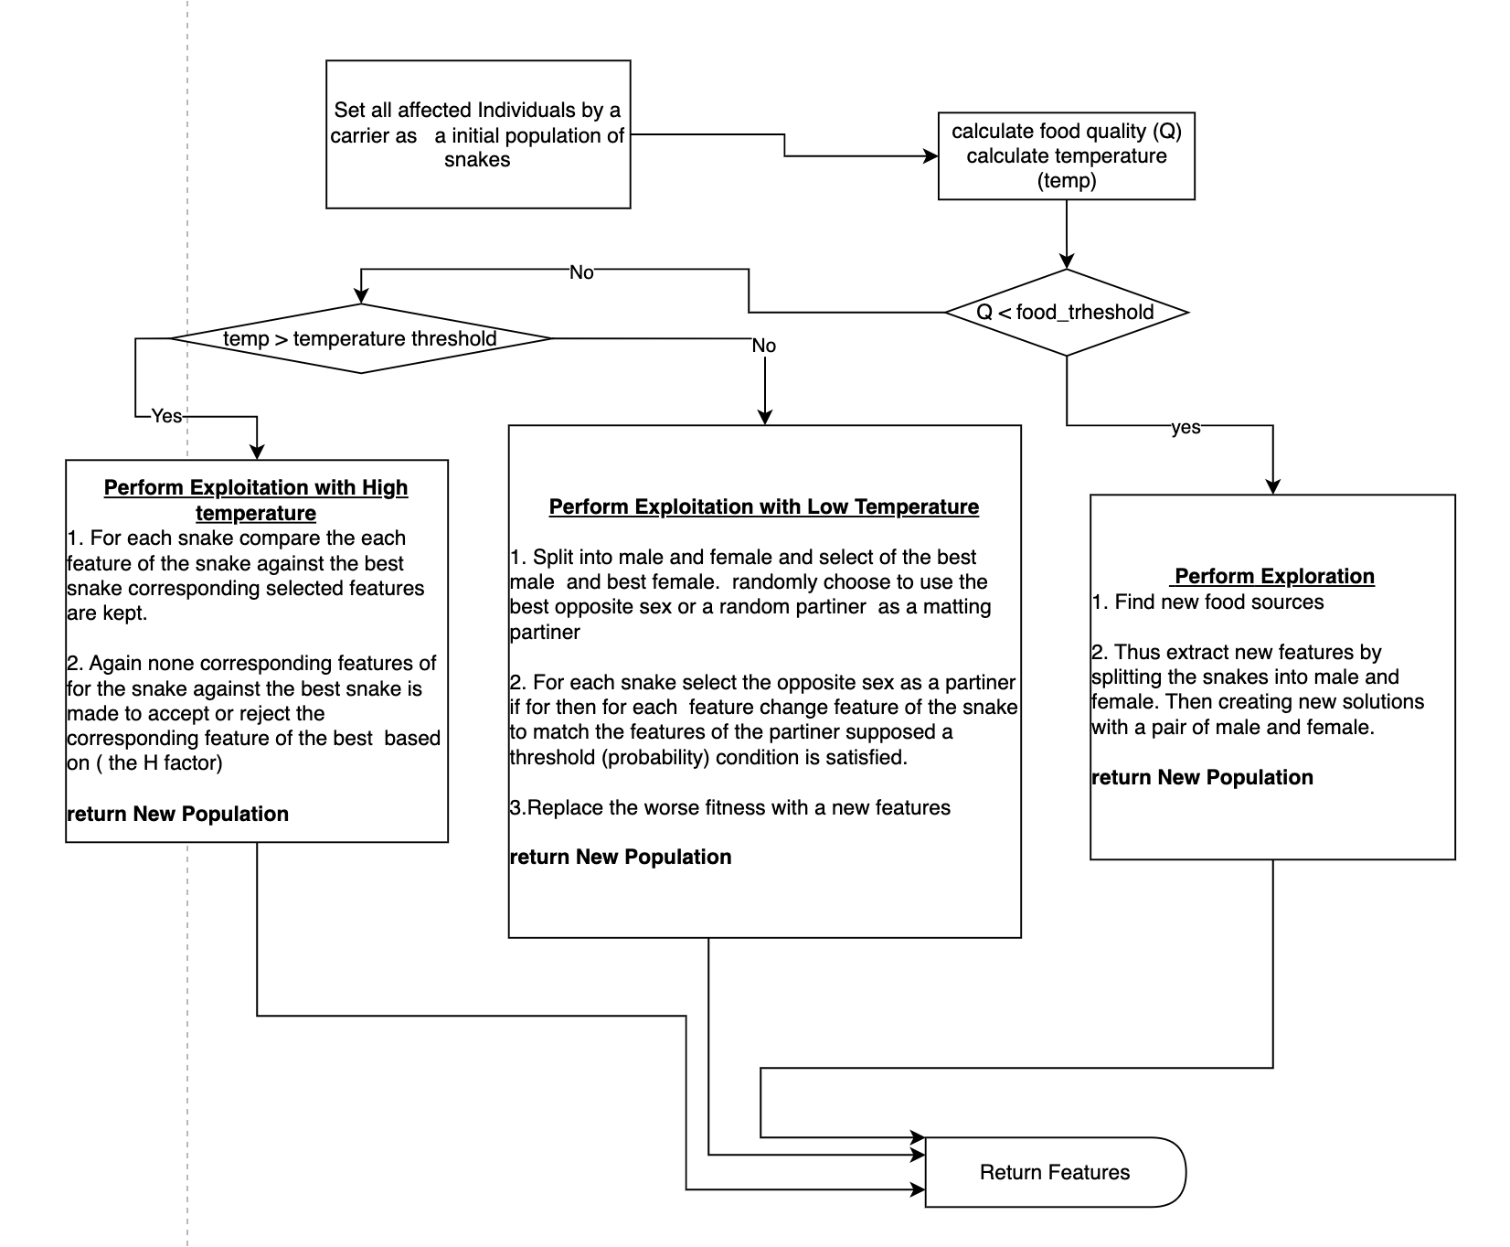
Flow Chat For intergration

Slide 8
ACO ( Ant Colony Optimization )
Ant Colony Optimization (ACO) is a nature-inspired metaheuristic that mimics how real ants find the shortest path between their nest and food sources. Ants lay down a chemical called pheromone, and over time, paths with stronger pheromone attract more ants, reinforcing good solutions.
ACO is widely used to solve combinatorial optimization problems like: Traveling Salesman Problem (TSP) , Scheduling , Routing , Feature Selection.
Focusing on parameters like : Pheromone trail value, Importance of pheromone, Importance of heuristic information, Heuristic value, Pheromone evaporation rate etc.

Slide 9
Research: Feature Selection for Classification Using an Ant Colony System ,
Authors: Nadia Abd-Alsabour & Marcus Randall School of Information Technology, Bond University, Australia
Key Contributions of the Paper:
Proposed a Binary ACO variant tailored for feature selection.
No construction graph — instead used binary vectors (1 = select, 0 = skip).
New move probability rule
Used both:
Local pheromone update (exploration)
Global update by best ant (exploitation)
Wrapper-based approach using SVM accuracy as the fitness function.
Tested on 10 datasets (UCI + statistical) and outperformed traditional methods like GA, PSO, and CBPSO in accuracy.
Published in: 6th IEEE International Conference on e-Science Workshops, 2010

Slide 10
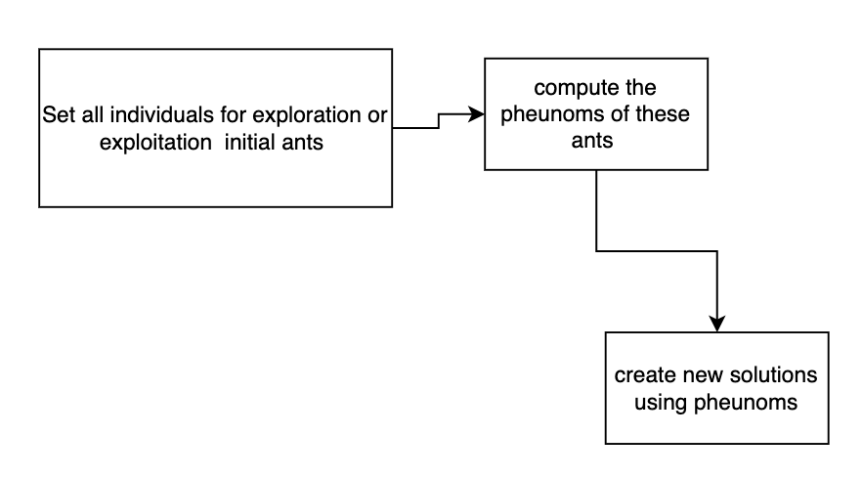
Flow chat for ACO integration

Slide 11
Why ACO strategy
Uses binary encoding — same as BEOA.
Each ACO run is stateless — resets every generation. Thus Learns which features are useful without prior knowledge.
Feature subset length is flexible — aligns with BEOA dynamics.
Can serve as a local exploitation mechanism in BEOA.
Easily plugged in as a refinement phase after mutation/crossover.

Slide 12
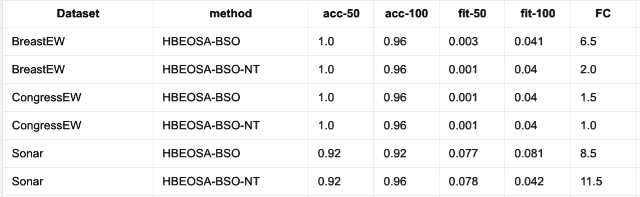
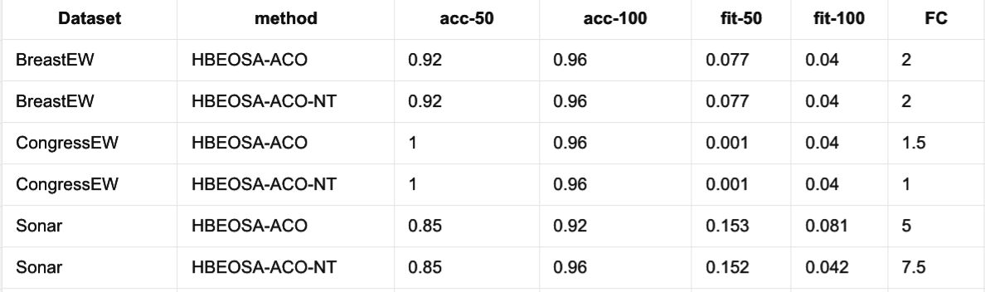
Results

Slide 15
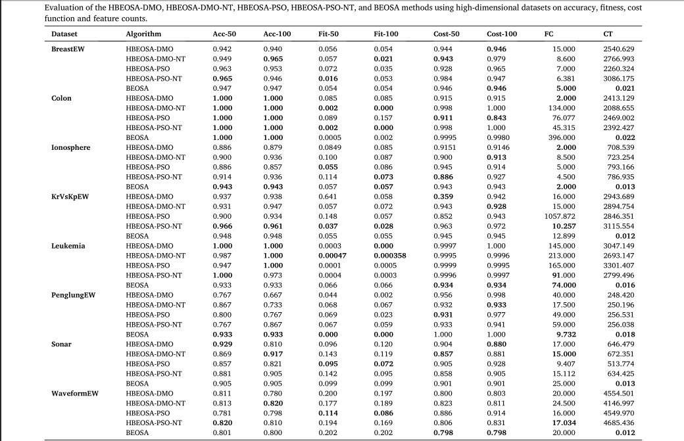
RESULT INTERPRETATION
Evaluation of the HBEOSA-DMO, HBEOSA-DMO-NT, HBEOSA-PSO, HBEOSA-PSO-NT, BEOSA
methods using high-dimensional datasets on accuracy, fitness, cost function and feature counts.

Slide 16
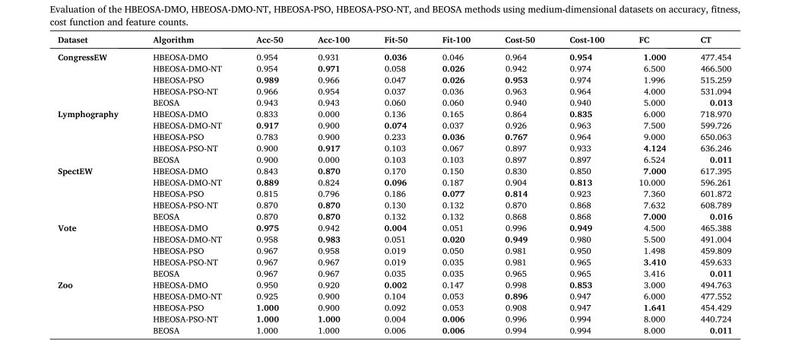
RESULT INTERPRETATION
Evaluation of the HBEOSA-DMO, HBEOSA-DMO-NT, HBEOSA-PSO, HBEOSA-PSO-NT, BEOSA
methods using medium-dimensional datasets on accuracy, fitness, cost function, and feature counts.

Slide 17
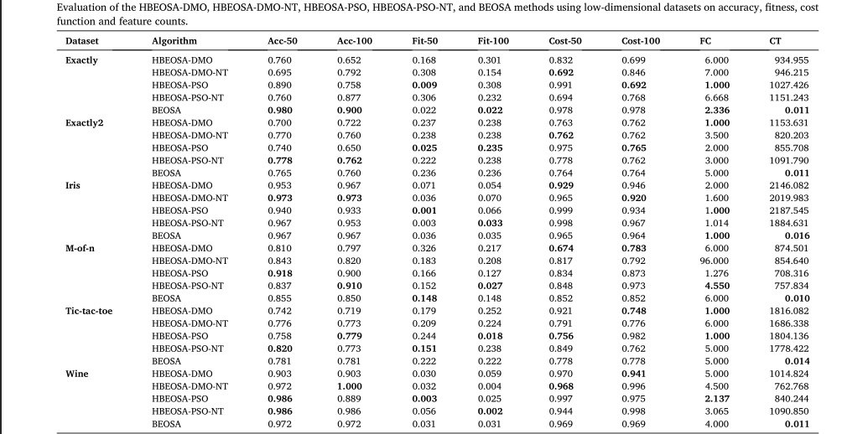
RESULT INTERPRETATION
Evaluation of the HBEOSA-DMO, HBEOSA-DMO-NT, HBEOSA-PSO, HBEOSA-PSO-NT, BEOSA
methods using Low-dimensional datasets on accuracy, fitness, cost function, and feature counts.

Slide 18
Questions

